Slide 1

Smart Door Lock System
Major Project - II
Problem Statement:
Design and implementation of an IoT-enabled Smart Door Lock System for enhanced security and convenience, utilizing NodeMCU and Blynk for remote authentication and monitoring.
Project Group Number: 39
Group Member Details:
Jividha koshti 0187CS211080
Manika Shrivastava 0187CS211094
Hamza ul hasan 0187CS211069
Ritika Dubey 0187CS211137
Guide Details : Prof. Amit Swami

Slide 2
Idea/Approach Details
Abstract:
In today's world, security is a prime concern for homes, offices, and institutions. Traditional lock-and-key mechanisms are prone to security risks such as key duplication and unauthorized access. This project proposes an IoT-based Smart Door Lock System that enhances security through NodeMCU and the Blynk app for remote access control. The system allows authorized users to lock and unlock the door via a mobile application, eliminating the need for physical keys. Real-time status updates and access logs ensure secure monitoring. The Wi-Fi-enabled NodeMCU microcontroller connects with the Blynk cloud to process authentication requests, granting access based on predefined permissions. This solution provides keyless entry, remote monitoring, and enhanced security, making it an efficient and user-friendly alternative to conventional locking systems.
User Interface -
Blynk’s Dashboard
Setup-
NodeMCU (ESP8266/ESP32)
Relay Module
Power Supply
Idea/Approach
The IoT-based Smart Door Lock System aims to enhance home and office security by allowing users to control and monitor door access remotely. Traditional locks are prone to issues like key misplacement, duplication, or break-ins. This system replaces conventional locks with a smart, keyless solution using NodeMCU and the Blynk app, enabling real-time access control and monitoring through a smartphone.

Slide 3
Project Requirements
Functional Requirements
Non Functional Requirements
User Authentication: The system should allow only authorized users to unlock the door via the Blynk app.
Remote Access Control: Users must be able to lock/unlock the door remotely through a mobile interface.
Real-time Status Updates: The system should display the current door status (Locked/Unlocked) in the app.
Access Logging: Logs should be maintained for each access attempt, recording time and user details.
Intrusion Alerts: Unauthorized access attempts should trigger notifications to the user’sphone..
Security & Reliability: The system must ensure secure data transmission and reliable Wi-Fi connectivity.
User-Friendly Interface: The Blynk app UI should be simple and easy to navigate.
Low Power Consumption: The system should operate efficiently using minimal power resources.
Scalability: The design should allow future enhancements, such as adding fingerprint or RFID access.
Response Time: The system should have a fast response (<2s) for unlocking the door after a request..

Slide 4
Project Requirements
Hardware and Software requirements (Developer)
Hardware and Software requirements(Client)
⮚ Software :-
Arduino IDE
Blynk App
Wifi
⮚Hardware :-
Node MCU (ESP8266/ESP32)
.Relay Module
Electromagnetic/Solenoid Lock
Power Supply (5V/12V Adapter or Battery)
-Jump Wires & Breadboard
-Sensors (Optional)
⮚ Software :-
Blynk Mobile App
Wi-Fi Connectivity
User Authentication Credentials
⮚Hardware :-
Smartphone (Android/iOS)
Stable Wi-Fi Connection
Smart Lock Hardware

Slide 5
Applications
Banking & Financial Institutions: Protects vaults and high-security areas with IoT-controlled locks.
Provides multi-level authentication for enhanced security.
Smart Cities & Public Infrastructure: Can be used in government offices, metro stations, or secured zones for access control.
Helps implement automated, contactless security solutions.
Home Security: Provides secure and remote-controlled door access for homeowners.
Eliminates the need for traditional keys, reducing the risk of lost or duplicated keys.
Office & Workplace Access Control: Restricts unauthorized entry and allows role-based access for employees.
Logs entry and exit times for monitoring attendance.

Slide 6
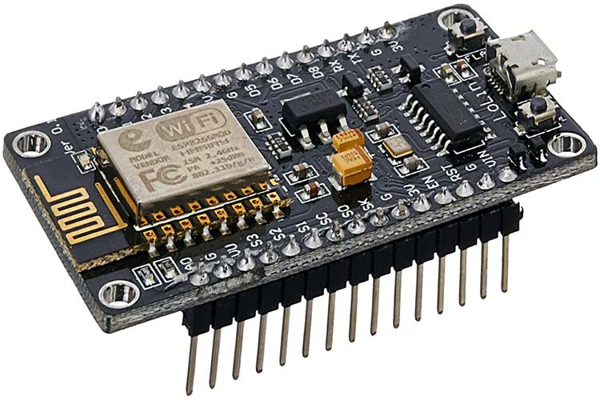
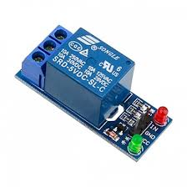
Hardware Components
NodeMCU (Microcontroller)
Relay Module
A powerful, low-cost microcontroller with integrated Wi-Fi and Bluetooth capabilities, widely used in IoT and embedded applications.
Supports both Wi-Fi and Bluetooth, enabling versatile wireless communication for smart devices
It can collect data from sensors and transmit it wirelessly to cloud platforms or mobile apps for real-time monitoring.
A relay module is an electrically operated switch that allows you to control high-voltage or high-current devices (like door locks, motors, lights, etc.) with a low-voltage control signal, such as from a microcontroller like NodeMCU.

Slide 7
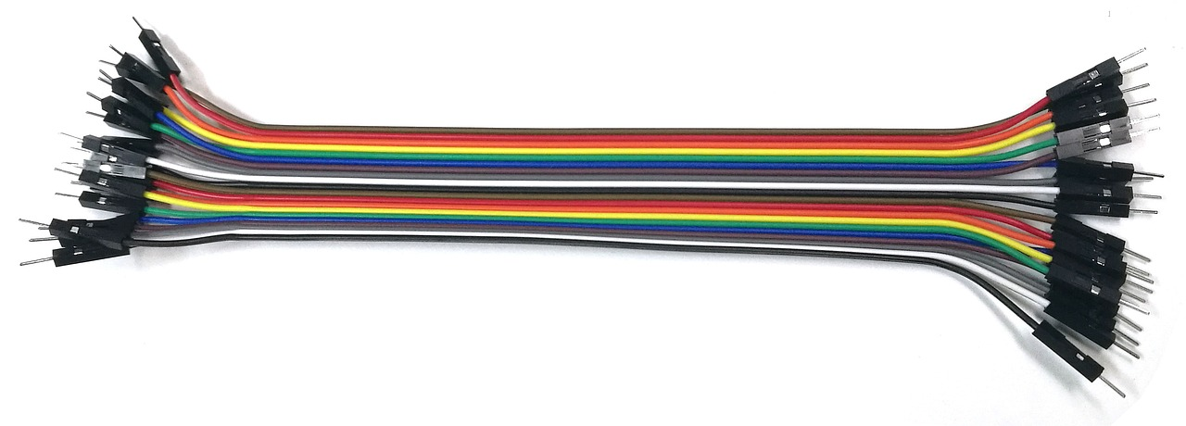
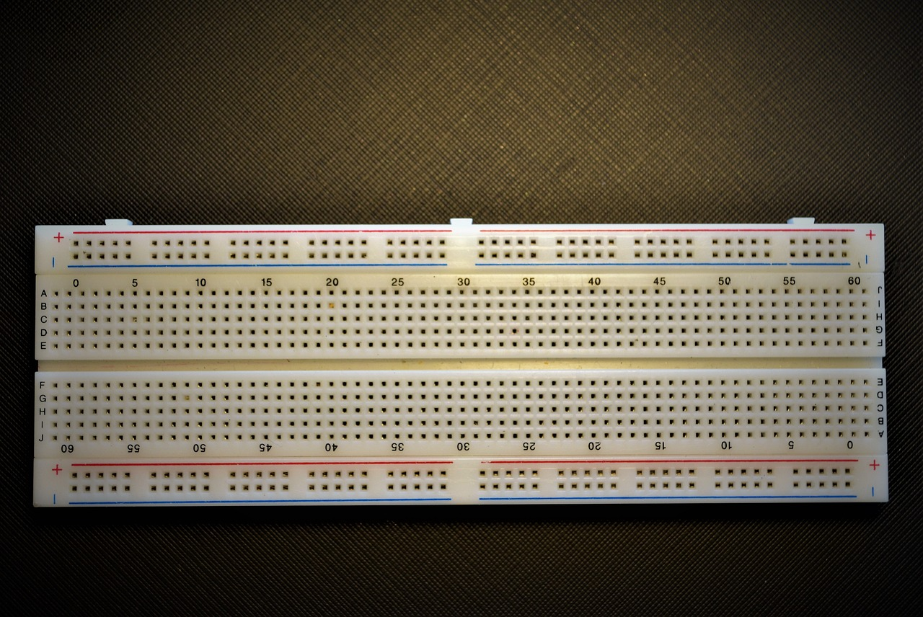
Jumper Wires
Breadboard
Definition: Jumper wires are short electrical wires with connectors at both ends, used to create circuits by connecting components on breadboards or other equipment.
Types: Available in male-to-male, female-to-female, and male-to-female configurations for flexibility in different circuit connections.
Use: Ideal for prototyping and experimenting with electronic circuits, allowing easy, temporary, and reusable connections between components without soldering.
A breadboard is used to create and test circuits without soldering, making it ideal for prototyping and experimentation.
Reusable Design: Consists of a grid of holes that allow easy insertion and removal of components like resistors, transistors, and wires, promoting flexibility.

Slide 8


